Slide 1
UNIT 5
MINING RICH DATA TYPES

Slide 2
Introduction :
Mining "rich data types" in data mining refers to the process of extracting meaningful patterns and insights from complex and diverse data formats that go beyond traditional structured, tabular data.
These rich data types often possess inherent relationships, structures, or temporal/spatial dependencies that require specialized techniques for effective analysis.

Slide 3
Mining text data (unstructured)
Text mining is a component of data mining that deals specifically with unstructured text data. It involves the use of natural language processing (NLP) techniques to extract useful information and insights from large amounts of unstructured text data. Text mining can be used as a preprocessing step for data mining or as a standalone process for specific tasks.

Slide 4
Text Mining in Data Mining?
Text mining in data mining is mostly used for, the unstructured text data that can be transformed into structured data that can be used for data mining tasks such as classification, clustering, and association rule mining. This allows organizations to gain insights from a wide range of data sources, such as customer feedback, social media posts, and news articles.

Slide 5
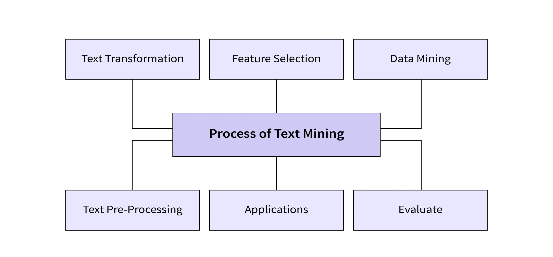
Text Mining Process

Slide 6
Gathering unstructured information from various sources accessible in various document organizations, for example, plain text, web pages, PDF records, etc.
Pre-processing and data cleansing tasks are performed to distinguish and eliminate inconsistency in the data. The data cleansing process makes sure to capture the genuine text, and it is performed to eliminate stop words stemming (the process of identifying the root of a certain word and indexing the data.
Processing and controlling tasks are applied to review and further clean the data set.
Pattern analysis is implemented in Management Information System.
Information processed in the above steps is utilized to extract important and applicable data for a powerful and convenient decision-making process and trend analysis.

Slide 7
Applications of Text Mining
Text mining in data mining has a wide range of applications across various industries and fields. Some of the common applications of text mining include the following -
Customer feedback analysis - Text mining can be used to analyze customer feedback data from various sources such as social media, online reviews, and customer support interactions. By analyzing customer feedback, businesses can gain insights into customer needs, preferences, and sentiments toward their products or services.
Social media analysis - Text mining can be used to analyze social media data to monitor brand reputation, track customer feedback, and understand customer behavior and sentiment towards products or services.

Slide 8
Healthcare - Text mining can also be used to extract insights from medical records, clinical notes, and other healthcare data to improve patient care, identify potential drug interactions, and support clinical research.
News analysis - Text mining can analyze a wide range of news articles to monitor ongoing trends, identify emerging issues, and understand public opinion on various topics.
E-commerce - Text mining can analyze product reviews, customer feedback, and search queries to understand customer behavior and preferences and to improve product recommendations and marketing strategies.

Slide 9
Spatial-temporal data (location + time)
The data that is related to both space and time is Spatiotemporal data. Spatiotemporal data mining retrieves interesting patterns and knowledge from spatiotemporal data.
Spatiotemporal Data mining helps us to find the value of the lands, the age of the rocks and precious stones, predict the weather patterns. Spatiotemporal data mining has many practical applications like GPS in mobile phones, timers, Internet-based map services, weather services, satellite, RFID, sensor.

Slide 10
Spatial-temporal data mining uses location and time-dependent data to uncover patterns and relationships across various fields, with examples including predicting weather events like hurricanes, analyzing traffic congestion by tracking vehicle movement, tracking wildlife behavior with GPS, and monitoring disease outbreaks to understand their spread over space and time.
Other applications include urban development analysis, crime pattern identification, social media trend mapping, and the impact of events on crowd movement.

Slide 11
Examples in various fields:
Meteorology & Environment:
Weather Pattern Discovery: Identifying recurring climate phenomena in different regions over time.
Disaster Prediction: Forecasting the path and intensity of hurricanes or the spread of forest fires.
Global Warming Trends: Analyzing long-term data to understand changes in global temperatures.

Slide 12
Urban Planning & Sociology:
City Development: Studying the evolutionary history of cities and land use patterns.
Crowd Movement Analysis: Correlating event locations and timings with mobile phone data to understand human trajectories and predict crowd behavior.
Social Media Analysis: Mapping the temporal and spatial spread of information or trends on social media platforms.

Slide 13
Graphs and Networks (relationships and interactions)
Graphs and networks are mathematical structures used to model relationships between objects. A graph consists of vertices (or nodes) and edges. Vertices represent entities, while edges represent the connections between these entities. For example, in a social network, vertices could be people, and edges could be the friendships between them.
Graphs represent relationships between objects in a structured way. This makes it easier to analyze and understand how different entities interact. For instance, you can use a graph to model how various websites link to each other, helping you understand the structure of the internet.

Slide 14
Networks are real-world applications of graphs. They take the abstract concept of a graph and apply it to practical scenarios. Examples include transportation networks, where vertices represent locations and edges represent routes, or biological networks, where vertices represent proteins and edges represent interactions between them.

Slide 15
Applications of Graphs and Networks
Graphs and networks are not just theoretical constructs; they have practical applications across various fields. Understanding these applications can help you see the value of graphs and networks in solving real-world problems.
Social Network Analysis
Social network analysis uses graphs to study relationships and interactions within social structures. Each person in a social network is a vertex, and their connections, such as friendships or professional relationships, are edges. By analyzing these graphs, you can identify key influencers, understand community structures, and detect patterns of communication. This analysis is valuable for marketing strategies, public health initiatives, and understanding social dynamics.

Slide 16
Route Optimization in Transportation
In transportation, graphs help optimize routes and improve efficiency. Cities or locations are vertices, and roads or paths are edges. Route optimization algorithms can find the shortest or fastest paths between points, reducing travel time and costs. This application is crucial for logistics companies, public transportation planning, and even ride-sharing services. By modeling transportation networks as graphs, you can identify bottlenecks and improve overall system performance.

Slide 17
Internet and Computer Network Design
The design and analysis of internet and computer networks rely heavily on graph theory. In these networks, devices like routers and switches are vertices, and the connections between them are edges. Graphs help in understanding the structure and flow of data, ensuring efficient and reliable communication. Network administrators use graphs to detect vulnerabilities, optimize data flow, and plan network expansions. This application is fundamental for maintaining the robustness and efficiency of modern communication systems.

Slide 18
Graphic design uses nodes, edges, and elements to represent and store graphic information. A graph-based diagram is a natural way to represent social networks and allows you to calculate certain parameters such as its structure, a person’s influence, and the shortest path between two people.
Examples of visual information can be found on social media sites (Figure).

Slide 19
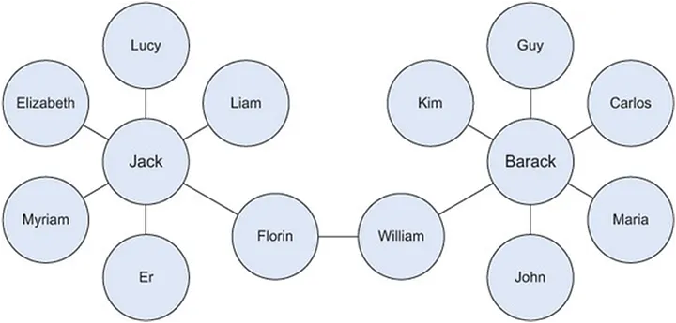

Slide 20
For example, on LinkedIn you can find people you know within the company. A list of Twitter followers is another example of graph-based data. Power and skill come from multiple designs combined into one.
For example, consider the link here to show ‘friends’ on Facebook. Consider another scenario where some people connect with business partners through LinkedIn. Consider a third number,
, based on the merits of movies on Netflix.

Slide 21
Data Mining Applications

Slide 22
Data Mining for sentiment and opinion
What is Sentiment Analysis?
Sentiment analysis is the process of classifying whether a block of text is positive, negative, or neutral. The goal that Sentiment mining tries to gain is to be analysed people’s opinions in a way that can help businesses expand. It focuses not only on polarity (positive, negative & neutral) but also on emotions (happy, sad, angry, etc.). It uses various Natural Language Processing algorithms such as Rule-based, Automatic, and Hybrid.
let's consider a scenario, if we want to analyze whether a product is satisfying customer requirements, or is there a need for this product in the market. We can use sentiment analysis to monitor that product’s reviews. Sentiment analysis is also efficient to use when there is a large set of unstructured data, and we want to classify that data by automatically tagging it. Net Promoter Score (NPS) surveys are used extensively to gain knowledge of how a customer perceives a product or service. Sentiment analysis also gained popularity due to its feature to process large volumes of NPS responses and obtain consistent results quickly.

Slide 23
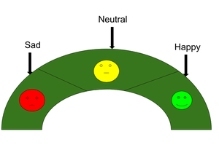
Why is Sentiment Analysis Important?
Sentiment analysis is the contextual meaning of words that indicates the social sentiment of a brand and also helps the business to determine whether the product they are manufacturing is going to make a demand in the market or not.
According to the survey,80% of the world’s data is unstructured. The data needs to be analyzed and be in a structured manner whether it is in the form of emails, texts, documents, articles, and many more.
Sentiment Analysis is required as it stores data in an efficient, cost friendly.
Sentiment analysis solves real-time issues and can help you solve all real-time scenarios.

Slide 24
Here are some key reasons why sentiment analysis is important for business:
Customer Feedback Analysis: Businesses can analyze customer reviews, comments, and feedback to understand the sentiment behind them helping in identifying areas for improvement and addressing customer concerns, ultimately enhancing customer satisfaction.
Brand Reputation Management: Sentiment analysis allows businesses to monitor their brand reputation in real-time.
By tracking mentions and sentiments on social media, review platforms, and other online channels, companies can respond promptly to both positive and negative sentiments, mitigating potential damage to their brand.
Product Development and Innovation: Understanding customer sentiment helps identify features and aspects of their products or services that are well-received or need improvement. This information is invaluable for product development and innovation, enabling companies to align their offerings with customer preferences.
Competitor Analysis: Sentiment Analysis can be used to compare the sentiment around a company's products or services with those of competitors.
Businesses identify their strengths and weaknesses relative to competitors, allowing for strategic decision-making.

Slide 25
Marketing Campaign Effectiveness
Businesses can evaluate the success of their marketing campaigns by analyzing the sentiment of online discussions and social media mentions.
Positive sentiment indicates that the campaign is resonating with the target audience, while negative sentiment may signal the need for adjustments.

Slide 26
What are the Types of Sentiment Analysis?
Fine-Grained Sentiment Analysis
This depends on the polarity base. This category can be designed as very positive, positive, neutral, negative, or very negative. The rating is done on a scale of 1 to 5. If the rating is 5 then it is very positive, 2 then negative, and 3 then neutral.
Emotion detection
The sentiments happy, sad, angry, upset, jolly, pleasant, and so on come under emotion detection. It is also known as a lexicon method of sentiment analysis.
Aspect-Based Sentiment Analysis
It focuses on a particular aspect for instance if a person wants to check the feature of the cell phone then it checks the aspect such as the battery, screen, and camera quality then aspect based is used.
Multilingual Sentiment Analysis
Multilingual consists of different languages where the classification needs to be done as positive, negative, and neutral. This is highly challenging and comparatively difficult.

Slide 27
How does Sentiment Analysis work?
Sentiment Analysis in NLP, is used to determine the sentiment expressed in a piece of text, such as a review, comment, or social media post.
The goal is to identify whether the expressed sentiment is positive, negative, or neutral. let's understand the overview in general two steps:
Preprocessing
Starting with collecting the text data that needs to be analysed for sentiment like customer reviews, social media posts, news articles, or any other form of textual content. The collected text is pre-processed to clean and standardize the data with various tasks:
Removing irrelevant information (e.g., HTML tags, special characters).
Tokenization: Breaking the text into individual words or tokens.
Removing stop words (common words like "and," "the," etc. that don't contribute much to sentiment).
Stemming or Lemmatization: Reducing words to their root form.

Slide 28
What are the Approaches to Sentiment Analysis?
There are three main approaches used:
Rule-based
Over here, the lexicon method, tokenization, and parsing come in the rule-based. The approach is that counts the number of positive and negative words in the given dataset. If the number of positive words is greater than the number of negative words then the sentiment is positive else vice-versa.
Machine Learning
This approach works on the machine learning technique. Firstly, the datasets are trained and predictive analysis is done. The next process is the extraction of words from the text is done. This text extraction can be done using different techniques such as Naive Bayes, Support Vector machines, hidden Markov model, and conditional random fields like this machine learning techniques are used.
Neural Network
In the last few years neural networks have evolved at a very rate. It involves using artificial neural networks, which are inspired by the structure of the human brain, to classify text into positive, negative, or neutral sentiments. it has Recurrent neural networks, Long short-term memory, Gated recurrent unit, etc to process sequential data like text.
Hybrid Approach
It is the combination of two or more approaches i.e. rule-based and Machine Learning approaches. The surplus is that the accuracy is high compared to the other two approaches.

Slide 29
Sentiment analysis Use Cases
Sentiment Analysis has a wide range of applications as:
Social Media
If for instance the comments on social media side as Instagram, over here all the reviews are analyzed and categorized as positive, negative, and neutral.
Nike Analyzing Instagram Sentiment for New Shoe Launch
Nike, a leading sportswear brand, launched a new line of running shoes with the goal of reaching a younger audience. To understand user perception and assess the campaign's effectiveness, Nike analyzed the sentiment of comments on its Instagram posts related to the new shoes.
Nike collected all comments from the past month on Instagram posts featuring the new shoes.
A sentiment analysis tool was used to categorize each comment as positive, negative, or neutral.

Slide 30
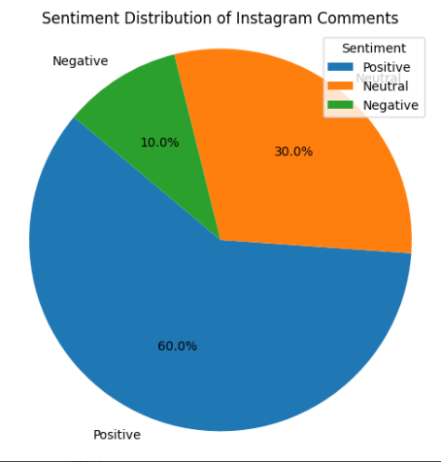

Slide 31
Data mining for truth discovery and misinformation identification
The digital age, particularly the rise of social media, has intensified the challenge of discerning truthful information from misinformation, often referred to as "fake news". Data mining offers powerful tools to address this challenge by extracting meaningful patterns and insights from vast datasets, enabling the development of techniques for:
1. Truth discovery
This involves identifying the factual correctness of claims when multiple data sources provide potentially conflicting information. Traditional approaches often rely on majority voting, assuming most sources are reliable. this can be unreliable, especially in situations where a majority of sources might be spreading false information, or when dealing with data sparsity, where only a few sources provide information.

Slide 32
Data mining techniques address these limitations by:
Estimating source trustworthiness: Sophisticated models evaluate the reliability of sources, attributing greater importance to information from more trustworthy sources. This can be achieved through iterative processes that refine trustworthiness scores and assess the accuracy of claims provided by sources.
Handling conflicting information: Algorithms analyze discrepancies and patterns across multiple sources to determine the most probable truth.
Considering factors like copying behavior: Identifying if a source is simply copying information from another can help assign appropriate weights to claims and prevent the rapid spread of misinformation

Slide 33
2. Misinformation detection
Data mining approaches are employed to identify and classify fake news and other forms of misinformation. This involves analyzing various features of online content and user behavior to determine the veracity of information. Techniques include:
Textual features: Examining linguistic styles, presence of sensational headlines, use of uppercase letters, and the inclusion of quotes can reveal patterns associated with fake news
Social context and network analysis: Investigating user engagement, propagation paths, and the overall spread of information within social networks can provide insights into misinformation campaigns.
Multimodal analysis: Combining information from different modalities (text, images, videos) to detect inconsistencies and manipulations
Machine learning and deep learning: Algorithms like Logistic Regression, Random Forests, Support Vector Machines, Convolutional Neural Networks, and Recurrent Neural Networks are trained on large datasets to classify news articles as true or fake.

Slide 34
Information and disease propagation
Propagation refers to the spread of something through a network—this could be information (e.g., news, rumors, memes) or disease (e.g., viruses, epidemics, pandemics).
Data mining provides tools to discover patterns, predict spread, and design interventions using large datasets such as social media logs, health records, or epidemiological data.

Slide 35
Data Mining in Information Propagation
Goal: Understand how news, rumors, advertisements, or misinformation spread in social networks.
Key Tasks:
  Influence Analysis: Identify key influencers who maximize information spread.
  Rumor Detection: Detect and prevent misinformation.
  Virality Prediction: Predict whether a post/video/message will go viral.
Techniques Used:
  Graph mining (network centrality, community detection).
  Text mining (NLP for sentiment and topic detection).
  Predictive models (machine learning for trend prediction).
Applications:
  Marketing (viral ads, brand promotions).
  Fake news detection.
  Crisis communication (how fast emergency alerts spread).

Slide 36
Data Mining in Disease Propagation
Goal: Track and predict disease spread through populations.
Key Tasks:
  Epidemic Modeling: Forecast infection rates and epidemic curves.
  Hotspot Detection: Find locations with rising infection cases.
  Risk Prediction: Identify individuals/communities at high risk.
Techniques Used:
  Spatio-temporal data mining (cases across time & geography).
  Social network analysis (contact tracing).
  Machine learning & deep learning (predict next outbreak, severity).
Applications:
  COVID-19 spread prediction.
  Public health decision-making (lockdowns, vaccination campaigns).
  Resource allocation (hospitals, medicines, vaccines)

Slide 37
Common Approaches for Both Domains
Network Mining:
  Both information and disease spread over networks (social, biological, contact networks).
Epidemic Models:
  SIR / SEIR models used in epidemiology also apply to information spread (susceptible → exposed → infected → recovered).
Big Data Analytics:
  Use large-scale data from Twitter, Facebook, mobility data, IoT, healthcare databases.
Visualization & Simulation:
  Predict “what if” scenarios (e.g., if vaccination rate increases, or if a rumor is stopped early).

Slide 38
Challenges
Data quality (noisy social media data, underreported disease cases).
Privacy & ethics (health data, user tracking).
Dynamic environments (mutation of virus, new social platforms).

Slide 39
Productivity and team science
Productivity: The efficiency of individuals, teams, or organizations in producing desired outcomes.
Team Science: The study of how teams collaborate, communicate, and generate scientific or innovative outcomes.
Data Mining Role: Extract hidden patterns from organizational, behavioral, and collaborative data to improve performance, collaboration, and decision-making.

Slide 40
Data Mining for Productivity
Goals
Understand what factors influence productivity (e.g., workload balance, communication, meeting frequency).
Identify early warning signals for decreased performance, burnout, or bottlenecks.
Provide recommendations to enhance individual and team efficiency.
Data Sources
Work logs & task records: Data from project management tools like Jira, Trello.
Communication data: Emails, Slack/Teams chats, meeting records.
HR data: Attendance, leave records, performance appraisals.
Sensor/IoT data: Smart office sensors measuring space usage, activity, or ergonomics.

Slide 41
Techniques & Examples
Clustering: Grouping employees/projects into “high-performing,” “average,” and “at-risk” clusters.
Classification & Prediction:
  Predicting whether a project will meet a deadline.
  Detecting which employees may face productivity drops.
Association Rule Mining: Example: “Employees who spend >6 hrs/week in meetings are 40% less likely to meet deadlines.”
Sentiment & Text Mining: Analyzing employee feedback emails or chats to measure morale, satisfaction, and motivation.
Applications
Performance analytics dashboards.
Intelligent task scheduling.
Training and skill gap analysis.
Reducing time-wasting activities (unnecessary meetings, duplicated work).

Slide 42
Data Mining for Team Science
Goals
Discover how teams collaborate, share knowledge, and generate innovations.
Find patterns that make research teams more effective and impactful.
Data Sources
Scientific publication data: Authorship, citations, journals.
Research collaboration platforms: Zoom, MS Teams, Slack.
Grants and project records: Who collaborates, on what, and with what outcome.
Patent & innovation data: To track team-based inventions.

Slide 43
Techniques & Examples
Social Network Analysis (SNA):
  Maps relationships between researchers.
  Identifies central figures (“influential scientists”) and isolated groups.
Text Mining:
  Extract topics, keywords, and emerging trends from research papers.
  Detect interdisciplinary collaboration (e.g., AI + Medicine).
Predictive Modeling:
  Predict whether a research team’s project will result in high-impact publications.
  Forecast chances of grant approval based on proposal text.
Temporal Mining:
  Study how collaboration evolves over time.
  Identify “burst periods” of innovation (e.g., during pandemic research).

Slide 44
Applications
Optimize team composition (mixing experts from different fields).
Encourage collaboration across institutions.
Improve research funding policies (identify high-impact areas).
Build collaboration dashboards for policymakers and universities.

Slide 45
Common Approaches
Network Mining:
  Productivity → Mapping workplace communication networks.
  Team Science → Mapping co-authorship or institutional collaboration networks.
Machine Learning & AI:
  Predict outcomes like project success, publication impact, or team efficiency.
Visualization Tools:
  Dashboards that show KPIs, team structures, collaboration intensity.

Slide 46
Challenges
Data Privacy: Sensitive HR and researcher communication data.
Bias: Models may favor certain types of employees or institutions.
Dynamic Nature: Teams evolve, productivity changes with time, so static models fail.
Measuring Quality vs. Quantity: High paper count ≠ high impact; long work hours ≠ productivity.

Slide 47


